Slide 1


Usman Arshad
12 October 2023

Slide 2

Outline
Executive Summary
Introduction
Methodology
Results
Conclusion
Appendix

Slide 3
Executive Summary
Summary of methodologies
Data Collection through API
Data Collection with Web Scraping
Data Wrangling
Exploratory Data Analysis with SQL
Exploratory Data Analysis with Data Visualization
Interactive Visual Analytics with Folium
Machine Learning Prediction
Summary of all results
Exploratory Data Analysis result
Interactive analytics in screenshots
Predictive Analytics result

Slide 4
Introduction
Project background and context
Space X, on their website, has disclosed that the cost of Falcon 9 rockets is $62 million, in stark contrast to the $165 million charged by other companies for a similar launch. This substantial cost savings can be attributed to the first stage rocket's reusability. Consequently, if we can ascertain the successful landing of the first stage, we can accurately determine the launch cost. This information can prove invaluable if a competing company wishes to submit a bid against Space X for a rocket launch contract. The objective of this project is to establish a machine learning pipeline that can predict the likelihood of a successful first-stage landing.
Problems you want to find answers
What factors contribute to the successful landing of a rocket?
The interplay of different features that influence the probability of a successful landing.
What operational conditions need to be in place for successful landing?

Slide 5

Section 1

Slide 6
Methodology
Executive Summary
Data collection methodology:
Data from Space X was obtained from 2 sources:
Space X API data: https://api.spacexdata.com/v4/rockets/
WebScraping data was obtained from: https://en.wikipedia.org/wiki/List_of_Falcon/_9/_and_Falcon_Heavy_launches
Execute Data Wrangling
The collected data was enhanced by generating a landing outcome label through the summarization and analysis of feature data.
Carry out exploratory data analysis (EDA) using visualization and SQL

Slide 7
Data Collection
Various methods were used to collect the data
Data collection was done using get request to the SpaceX API.
The response content is then decoded as a Json using .json() function call and turn it into a pandas dataframe using .json_normalize().
Then next step was to clean the data, checked for missing values and fill in missing values as necessary.
In addition, web scraping was performed from Wikipedia for Falcon 9 launch records with BeautifulSoup.
The objective was to extract the launch records as HTML table, parse the table and convert it to a pandas dataframe for future analysis.

Slide 8
Data Collection – SpaceX API
Various GET requests were executed on different endpoints of the SpaceX REST API to gather data about previous launches, which was then stored in a pandas dataframe.
Github link for SpaceX API Calls:
https://github.com/uxarsh/Applied-Data-Science-Capstone/blob/090afae49acb3bf7c017a80d1de63ab2afcf7178/jupyter-labs-spacex-data-collection-api.ipynb
Place your flowchart of SpaceX API calls here
Get request to SpaceX REST API
Normalize the response json object
Save response as a pandas dataframe
Subset the dataframe for selected features & a selected time frame & Falcon 9 launches
Replace missing values of features
Use dataframe columns to make other API calls to append additional information to the final dataframe

Slide 9
Data Collection - Scraping
A get request was performed on a selected Wiki page to extract launch records from an HTML table into a python dictionary and convert it to a dataframe
Github link: https://github.com/uxarsh/Applied-Data-Science-Capstone/blob/090afae49acb3bf7c017a80d1de63ab2afcf7178/jupyter-labs-webscraping.ipynb
Place your flowchart of web scraping here
Get request to Falcon9 Launch HTML page
Create BeautifulSoup object from the HTML response
Extract column names from table of interest
Create a dictionary with column name keys
Fill dictionary with launch records extracted from table rows
Create a dataframe from the dictionary

Slide 10
Data Wrangling
We employed a fundamental exploratory data analysis (EDA) to investigate the number of launches conducted at each site, categorized by orbit, as well as the launch outcomes based on the type of orbit.
The outcome feature was further processed to create our target variable ‘Class’, which classified successful and failed launches
GitHub URL for the data wrangling notebooks: https://github.com/uxarsh/Applied-Data-Science-Capstone/blob/090afae49acb3bf7c017a80d1de63ab2afcf7178/jupyter-spacex-data_wrangling_jupyterlite.jupyterlite.ipynb
Calculate number of launches per launch site
Calculate number of launches per orbit type
Calculate mission outcome per orbit type
Explore the different landing outcomes
Create a landing class variable to separate successful (1) vs unsuccessful (0) landings
Append the variable as the target feature ‘Class’ to the launch dataframe

Slide 11
EDA with Data Visualization
Three types of charts were used to explore the data:
We utilized scatter plots to examine the associations between these variables, with the landing outcomes color-coded. Specifically, we examined the relationships between Flight Number and Launch Site, Payload and Launch Site, Flight Number and Orbit Type, as well as Payload and Orbit Type.
A bar chart to visually inspect the relationship between success rate and orbit type
A line chart to observe trends in average launch success rate per year
We performed feature engineering by employing one-hot encoding (which involves creating dummy variables) for the categorical columns, followed by their conversion into the float data type.
GitHub URL for EDA with data visualization notebook: https://github.com/uxarsh/Applied-Data-Science-Capstone/blob/090afae49acb3bf7c017a80d1de63ab2afcf7178/eda-dataviz.ipynb

Slide 12
EDA with SQL
SQL queries were performed to:
Retrieve the names of the unique launch sites.
Show 5 entries where the launch site starts with the 'CCA' string.
Show the cumulative payload mass transported by boosters launched under the NASA (CRS) program.
Display the average payload mass carried by booster version F9 v1.1
List the date of the initial successful ground pad landing outcome.
Provide the names of boosters that achieved success in landing on a drone ship and had a payload mass greater than 4000 but less than 6000.
Compile the total count of both successful and failed mission outcomes.
List the names of the booster versions which have carried the maximum payload mass
List records with month, failure landing outcomes in drone ship, booster versions and launch_site for the months of 2015
Rank the count of landing between the date 2010-06-04 and 2017-03-20, in descending order
GitHub URL for EDA with SQL notebook: https://github.com/uxarsh/Applied-Data-Science-Capstone/blob/090afae49acb3bf7c017a80d1de63ab2afcf7178/sqllite.ipynb

Slide 13
Build an Interactive Map with Folium
A map was generated using Folium, with its center positioned at the NASA Johnson Space Center in Houston, Texas. Additionally, a circular object was constructed around the Space Center on the map.
To pinpoint various launch sites based on their latitude and longitude coordinates, circular objects with popup labels were added to the map. These popups would provide information about the respective launch sites when clicked.
Markers were generated and organized using a MarkerCluster object to display the outcomes (success or failure) for all launch records. This allows users to zoom in and out to explore the results efficiently.
Line objects were established to illustrate the distances from the launch sites to various points of interest, such as the nearest coastline point, railway, highway, or city. This visual representation aids in understanding the spatial relationships and distances involved.
GitHub URL for interactive map with Folium: https://github.com/uxarsh/Applied-Data-Science-Capstone/blob/a36c3acb57a7f018489f6d4315f09fb57bc6d884/launch_site_location_updated.ipynb

Slide 14
Build a Dashboard with Plotly Dash
A SpaceX Launch Records Dashboard was developed using Plotly Dash, enabling users to interactively explore and analyze the data. This dashboard provides a user-friendly interface for data visualization and exploration.
A dropdown menu was incorporated to offer users the option of viewing results for all launch sites collectively or for a specific launch site. This feature enhances user flexibility in exploring the data.
A pie chart was integrated into the dashboard to display the total number of successful launches per site when all sites are selected. When a single site is chosen, the pie chart illustrates the percentage of both successful and unsuccessful launches for that specific site. This visual element provides a clear overview of launch outcomes.
A scatter plot depicting Payload Mass and Class was incorporated into the dashboard. This scatter plot also utilizes different colors to represent various booster versions, facilitating the examination of the relationship between Payload Mass and the launch outcome (Class).
A Payload Range slicer was introduced, offering users the ability to filter the results of the scatter plot based on selected limits for Payload Mass. This interactive feature empowers users to refine their data exploration according to specific payload mass ranges of interest.
GitHub URL for Plotly Dash lab: https://github.com/uxarsh/Applied-Data-Science-Capstone/blob/44e28533202120b4ed3dcaf0477b2a1f51f86cbf/ploty.py

Slide 15
Predictive Analysis (Classification)
The dataframe was prepared for predictive analysis
Four modeling algorithms, namely logistic regression, support vector machine, decision trees, and k-nearest neighbors, were chosen for the predictive analysis. These algorithms are typically employed to build models and make predictions based on the prepared dataset.
For each model, the training set was used to train the model and obtain the best model parameters. The model was then evaluated using the test data.
The models were compared using accuracy scores and the results of confusion matrices. This comparison helps evaluate the models' performance and their ability to correctly classify data, providing insights into their effectiveness.
GitHub URL for predictive analysis lab: https://github.com/uxarsh/Applied-Data-Science-Capstone/blob/44e28533202120b4ed3dcaf0477b2a1f51f86cbf/Spacex%20machine%20learning%20prediction.ipynb
Create Target Variable (Y) and feature (X) dataframes
Standardize the features in the X dataframe
Split the dataframes X and Y into training and test data
Create a model object and a dictionary of parameters
Use Gridsearch to fit the model on the training set and save the model with the best parameters
Calculate the accuracy of the model on the test data, plot the confusion matrix, and compare results

Slide 16
Results
Exploratory data analysis results
Interactive analytics demo in screenshots
Predictive analysis results

Slide 17

Section 2

Slide 18
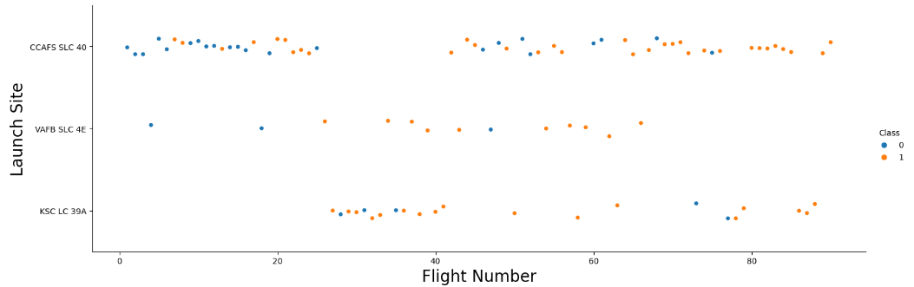
Flight Number vs. Launch Site
A similar pattern is noticeable across the three launch sites: as flight numbers increase, there appears to be a higher likelihood of successful landings.

Slide 19
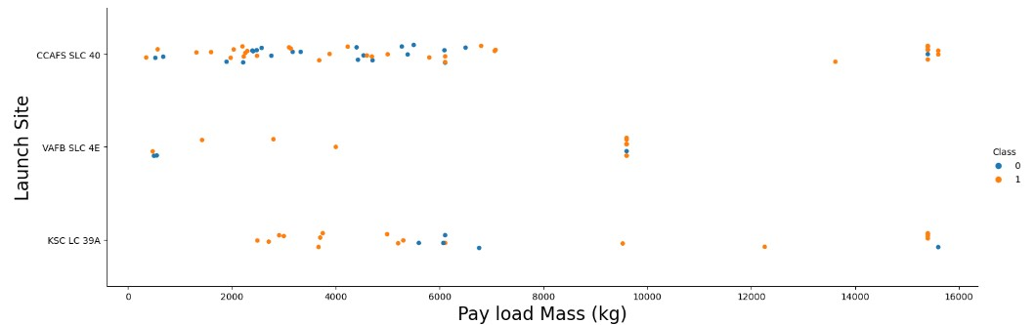
Payload vs. Launch Site
A comparable pattern was noted for the three launch sites: as payload mass increased, there was a tendency for more successful landings to occur.
The VAFB-SLC launch site did not witness any launches with a payload mass exceeding 10,000 kilograms.

Slide 20
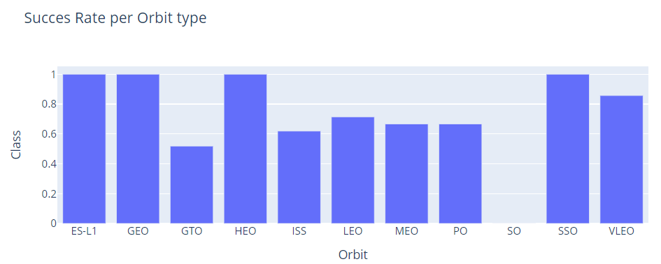
Success Rate vs. Orbit Type
There doesn't seem to be a relation between the orbit's altitude and the success of the landing.
The orbit types with the highest success rates are ES-L1, GEO, HEO, and SSO.

Slide 21
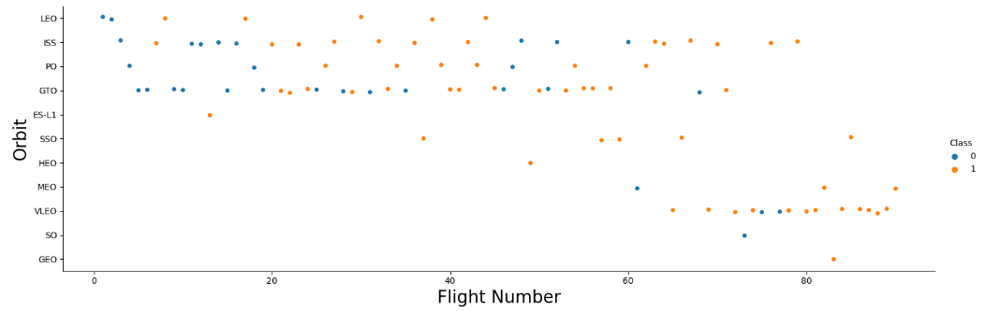
Flight Number vs. Orbit Type
In certain orbit types, such as LEO and PO, there was a tendency for the success rate to increase with the flight number. However, for other orbit types like ISS and GTO, no apparent relationship was evident between the success rate and flight number.
The orbit types with the highest success rates, ES-L1, GEO, HEO, and SSO, had a limited number of flights, typically five or fewer, and these flights were relatively recent, with flight numbers exceeding 40.

Slide 22
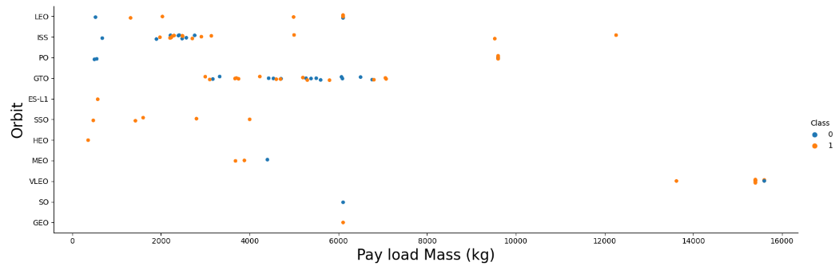
Payload vs. Orbit Type
The success rate for orbit types LEO, ISS, and PO appears to increase as the payload mass increases. However, for the GTO orbit, no discernible relationship is evident between the success rate and payload mass.
The orbit types with the highest success rates, ES-L1, GEO, HEO, and SSO, tend to have payload masses of approximately 6000 kilograms or less.

Slide 23
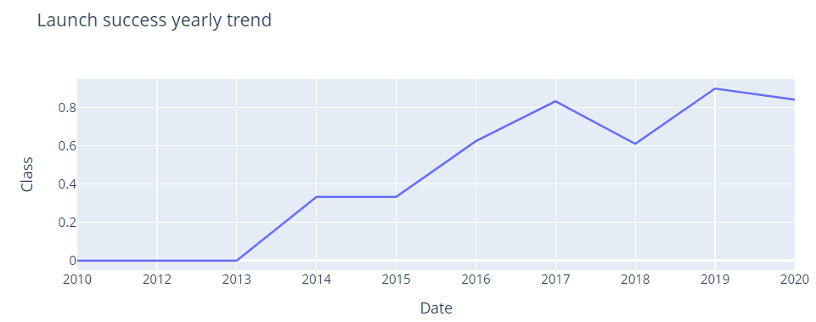
Launch Success Yearly Trend
Since 2013, there has been a general upward trend in the average success rate per year

Slide 24
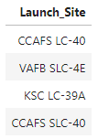
All Launch Site Names
Find the names of the unique launch sites
SpaceX launches Falcon 9 rockets from the following four launch sites: :

Slide 25
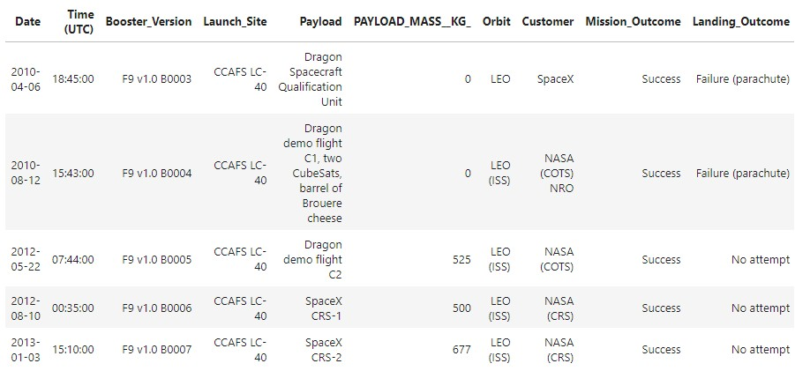
Launch Site Names Begin with 'CCA'
Find 5 records where launch sites begin with `CCA`
The subsequent five records are associated with the launch site CCAFS LC-40:

Slide 26
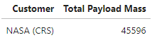
Total Payload Mass
Calculate the total payload carried by boosters from NASA
The cumulative payload mass transported by SpaceX rockets.
For all launches conducted for their NASA (CRS) customer, the total payload mass exceeds 45,000 kilograms.

Slide 27
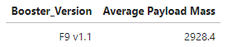
Average Payload Mass by F9 v1.1
Calculate the average payload mass carried by booster version F9 v1.1
The average payload mass transported by the booster version F
The average payload mass transported by the booster version F9 v1.1 is slightly above 2900 kilograms.

Slide 28
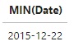
First Successful Ground Landing Date
Find the dates of the first successful landing outcome on ground pad
The date of the first successful landing outcome on a ground pad was indeed December 22nd, 2015

Slide 29
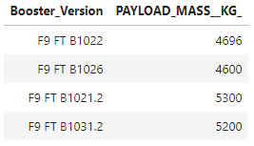
Successful Drone Ship Landing with Payload between 4000 and 6000
List the names of the boosters that have achieved successful landings on a drone ship and had a payload mass greater than 4000 but less than 6000 kilograms.
The subsequent four booster versions, which carried payload masses greater than 4000 kilograms but less than 6000 kilograms, have achieved successful landings on drone ships:

Slide 30
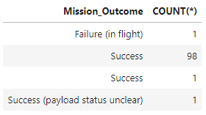
Total Number of Successful and Failure Mission Outcomes
Calculate the total number of successful and failed mission outcomes
The mission outcomes of SpaceX launches have predominantly been successful, with the exception of one case, which resulted in a failure during flight.

Slide 31
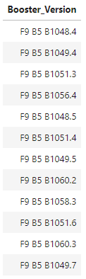
Boosters Carried Maximum Payload
List the names of the booster which have carried the maximum payload mass
The table on the right lists 12 booster versions, each of which has transported the maximum payload mass.

Slide 32
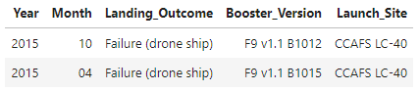
2015 Launch Records
List the records containing information about the month, failure in landing outcomes on a drone ship, booster version, and launch site for the year 2015.
During April and October 2015, two different booster versions launched from the CCAFS LC-40 launch site experienced failures in landing on a drone ship.

Slide 33
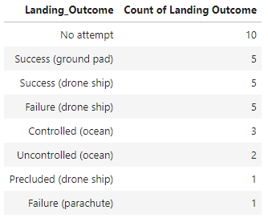
Rank Landing Outcomes Between 2010-06-04 and 2017-03-20
Rank the count of landing outcomes between the date 2010-06-04 and 2017-03-20, in descending order
From June 4, 2010, to March 20, 2017, there were ten instances where landing attempts were not made. During this period, there were five cases each of successful landings on ground pads and drone ships, as well as five cases of failed landings on drone ships.
Other landing outcomes had 3 or fewer cases.

Slide 34

Section 3

Slide 35
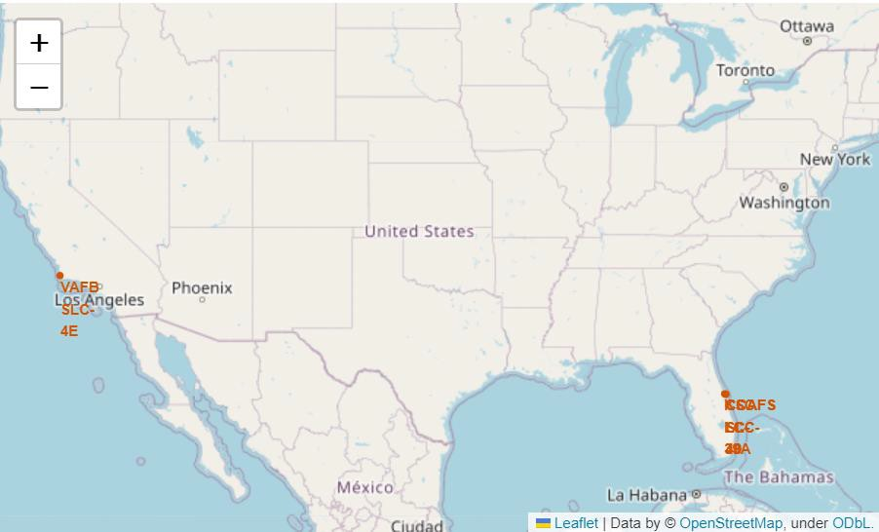
Launch Site Locations
All of the launch sites are situated in close proximity to the coastline.
The launch site VAFB SLC-4E is situated on the Pacific coast of the United States.
The other three launch sites are positioned along the Atlantic coast of the United States.

Slide 36
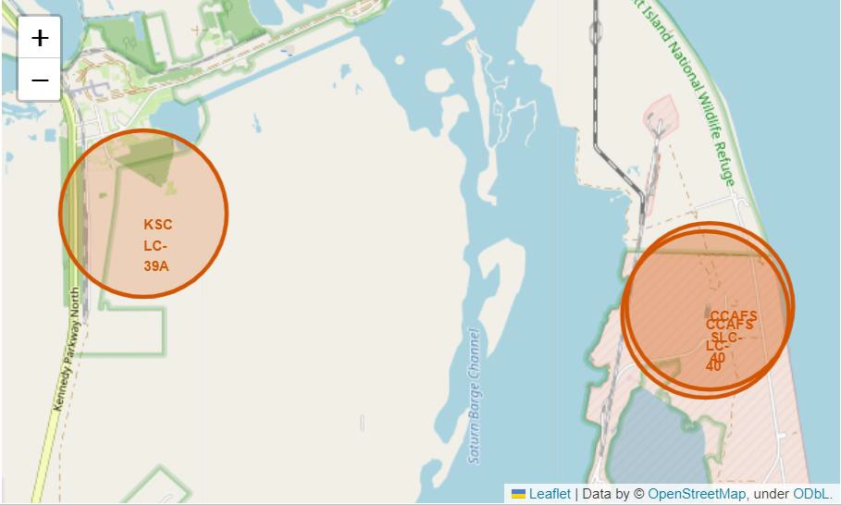
Launch Sites in the Atlantic coast of the USA
Launch sites CCAFS LC-40 and CCAFS
SLC-40 are in close proximity of each other

Slide 37
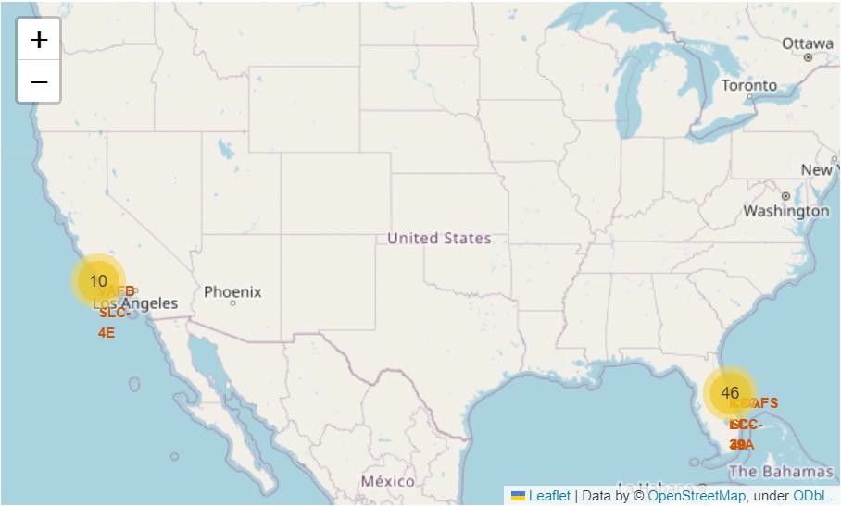
Location and Number of launches
The majority of launches have occurred at launch sites along the Atlantic coast of the United States.
Only ten launches have been documented at the launch site on the Pacific coast.

Slide 38
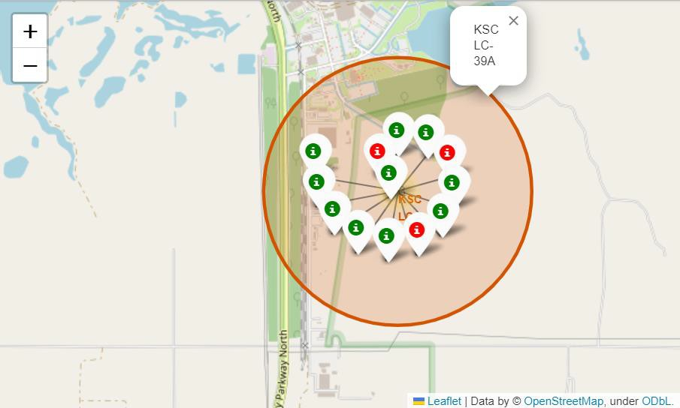
Launch Outcomes at Site KSC LC-39A
Out of the 13 launch records at the KSC LC-39A launch site, 10 of them had successful landings.

Slide 39
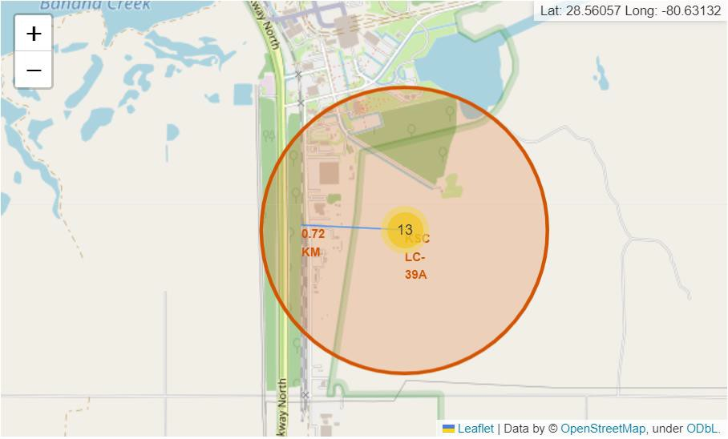
Proximities of Launch Site KSC LC-39A
All launch sites are situated near the coastline and are at a considerable distance from city centers.
The KSC LC-39A launch site is approximately 0.72 kilometers away from the nearest railway.

Slide 40

Section 4

Slide 41
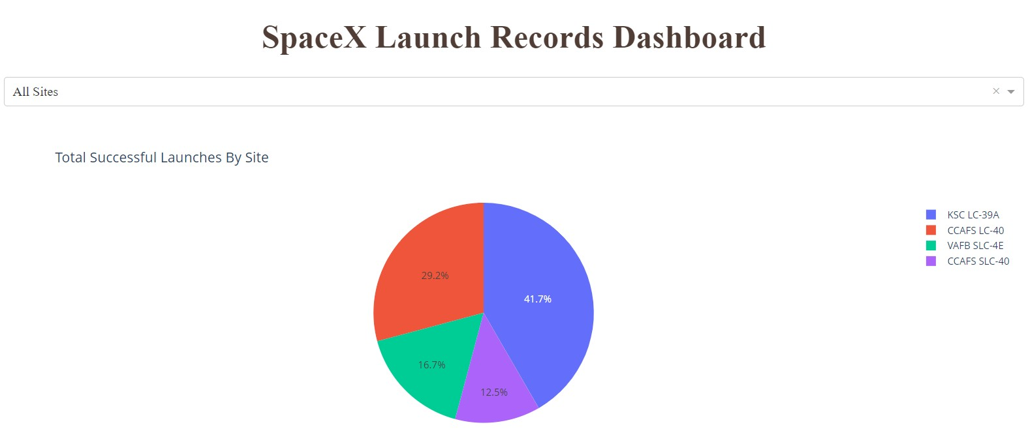
Proportion of Launch Success for All Sites
The launch site with the highest proportion of successful launches is the KSC LC-39A site, accounting for 41.7% of successes, followed by the CCAFS LC-40 site with 29.2%.

Slide 42
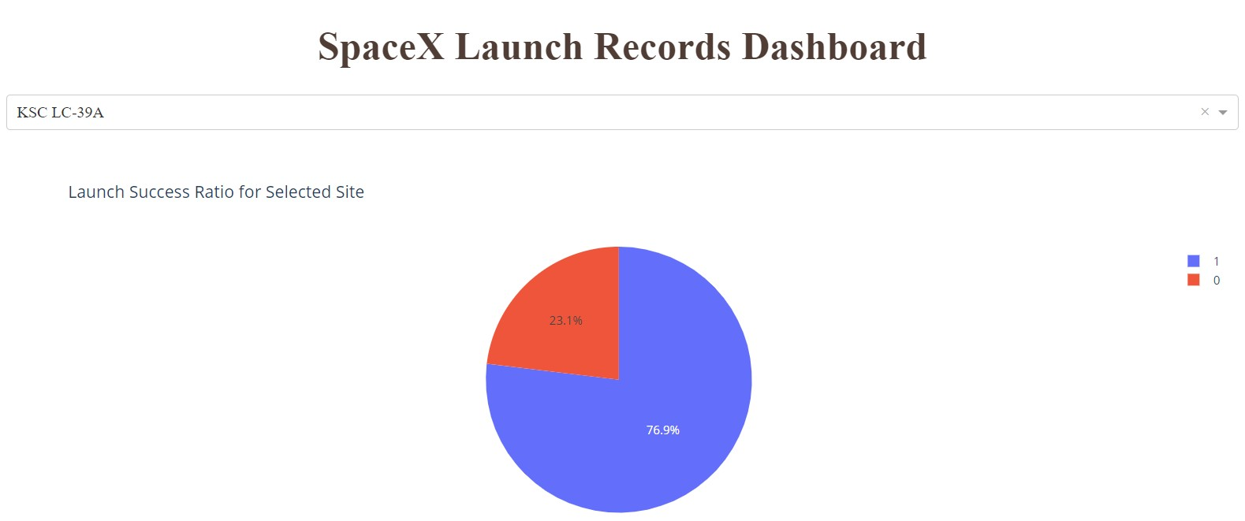
Launch Site with Highest Success Rate
The launch site KSC LC-39A achieved the highest launch success ratio, with a 76.9% success rate, representing 10 successful launches out of 13 in total.

Slide 43
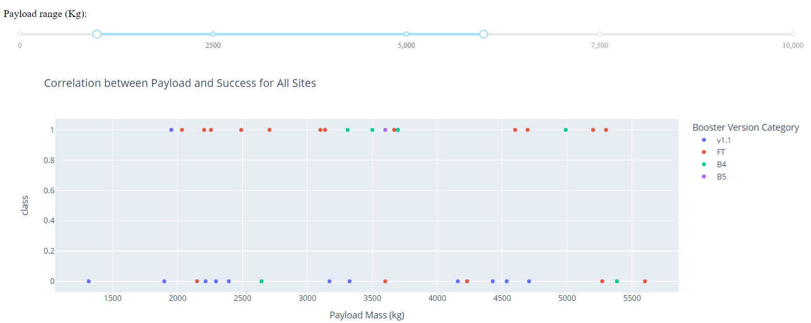
Correlation between payload and launch outcome (1)
When considering all launch sites, the payload mass range of approximately 2000 to 5500 kilograms exhibited the highest success rate.

Slide 44
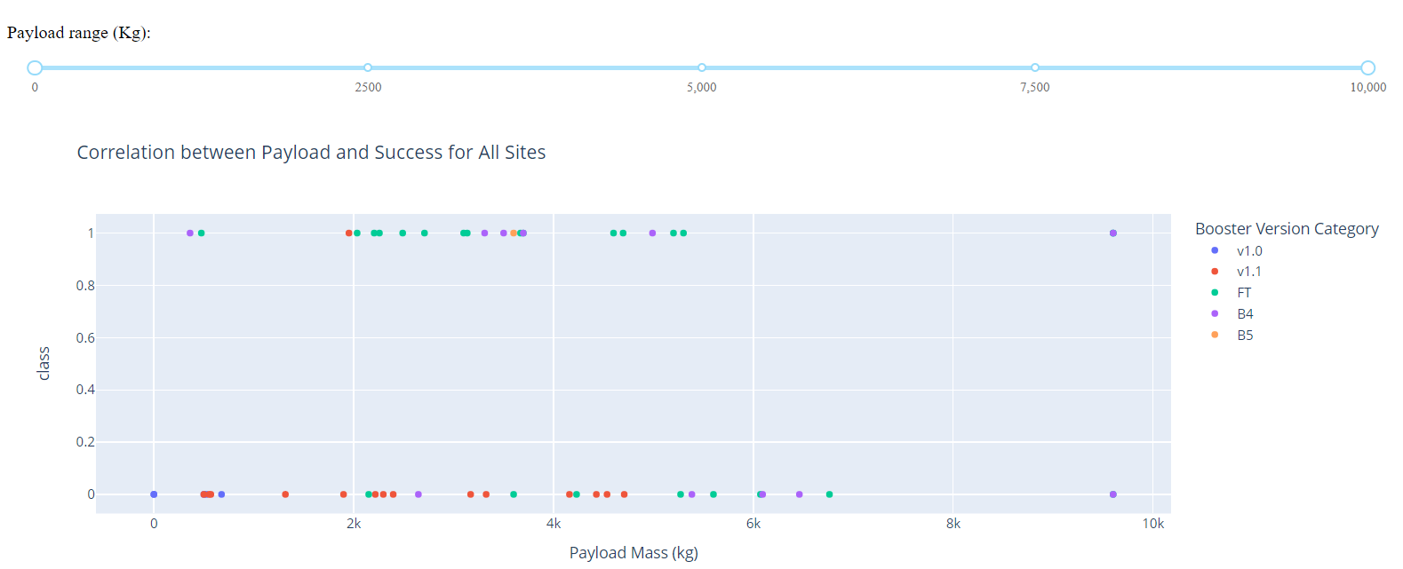
Correlation between payload and launch outcome (2)
Considering all launch sites and all payload masses, booster version FT showed the highest number of successful landings, while booster version v1.1 showed the highest number of failed 44 landings

Slide 45

Section 5

Slide 46
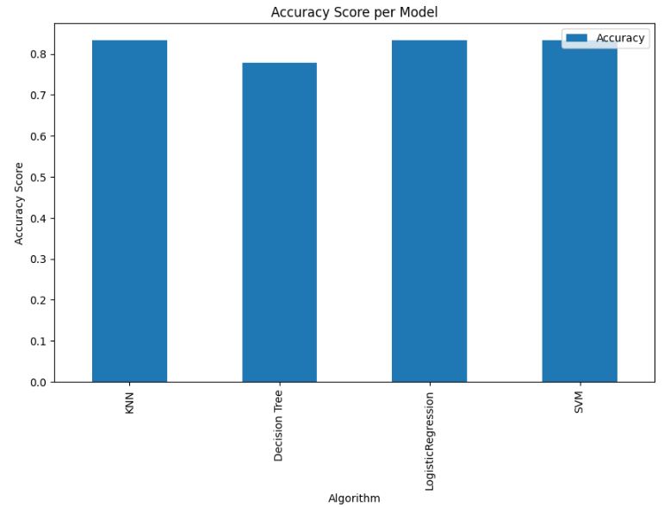
Classification Accuracy
The K Nearest Neighbor, Logistic Regression, and Support Vector Machine models all yielded identical accuracy scores of 0.8333 on the test data.
The Decision Tree model exhibited the lowest performance, achieving an accuracy score of 0.7777 on the test data.

Slide 47
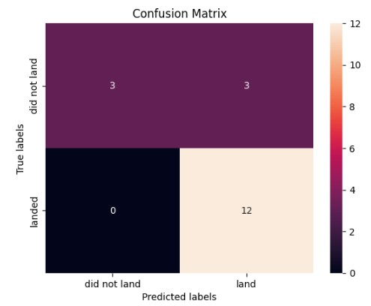
Confusion Matrix
The K Nearest Neighbor, Logistic Regression, and Support Vector Machine models produced identical results in the confusion matrix.
All successful landings were correctly classified, but three of the failed landings were incorrectly classified as successful

Slide 48
Conclusions
As flight numbers increased there were more successful landings, due likely to the experience gained and improvements made with time
In fact, the average success rate per year clearly increased between 2013 -2020
A significant number of the earliest flights, typically those with flight numbers ranging from 1 to 25, took place at the CCAFS SLC-40 launch site. Interestingly, the majority of these early flights experienced unsuccessful landings.
The launch site KSC LC-39A achieved the highest launch success ratio at 76.9%, and it's noteworthy that flights at this site commenced later than at other launch sites.
There didn't appear to be a straightforward relationship between orbit altitude and success rate. Orbit types with higher success rates tended to have a limited number of flights, and these flights were relatively recent, often involving payload masses of around 6000 kilograms or less.
When considering all launch sites, the payload mass range of approximately 2000 to 5500 kilograms exhibited the highest success rate.
Taking into account all launch sites and payload masses, booster version FT had the most successful landings, whereas booster version v1.1 had the highest number of failed landings.
The K Nearest Neighbor, Logistic Regression, and Support Vector Machine models all achieved an identical accuracy score of 0.8333 on the test data, and they also yielded the same results in the confusion matrix.

Slide 49
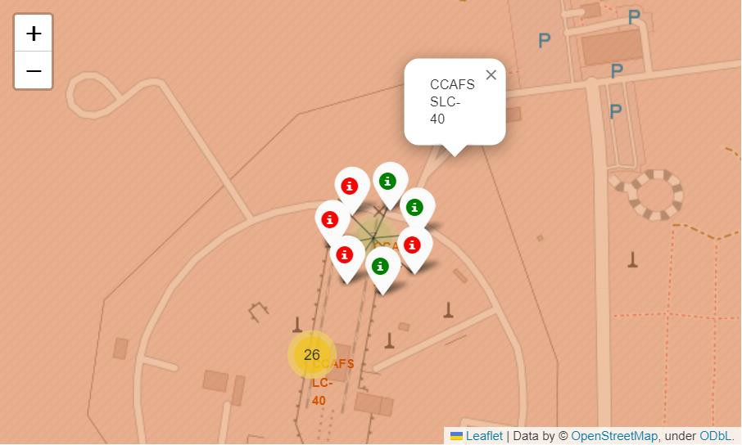
Appendix
The CCAFS SLC-40 site has experienced both successful and failed launches.

Slide 50
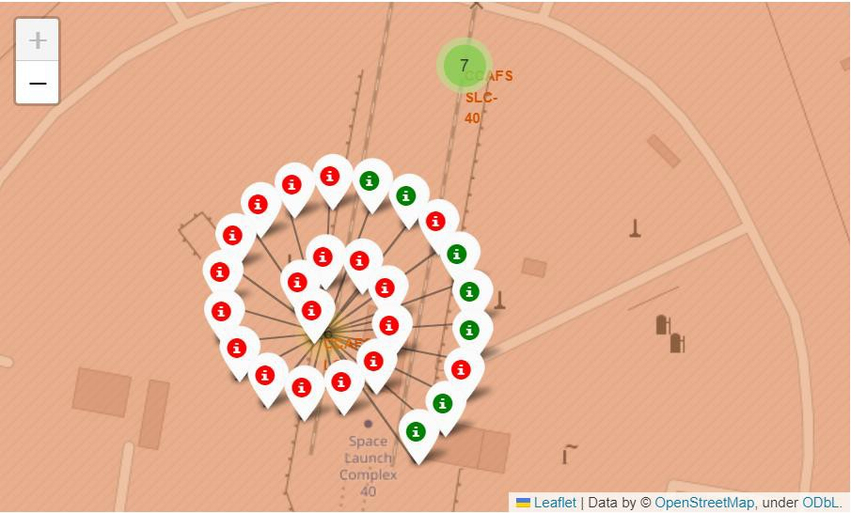
Appendix
The CCAFS LC-40 site has seen both successful and failed launches.

Slide 51
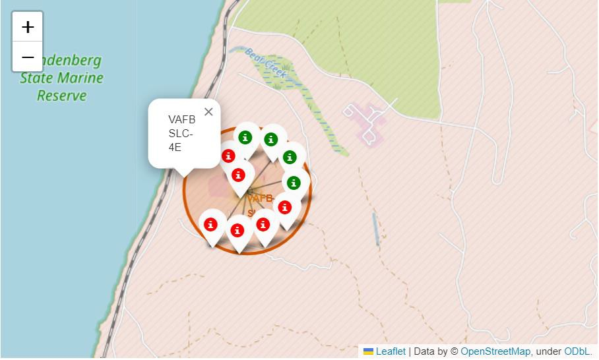
Appendix
Successful and failed launches at the VAFB SLC-4E site

Slide 52
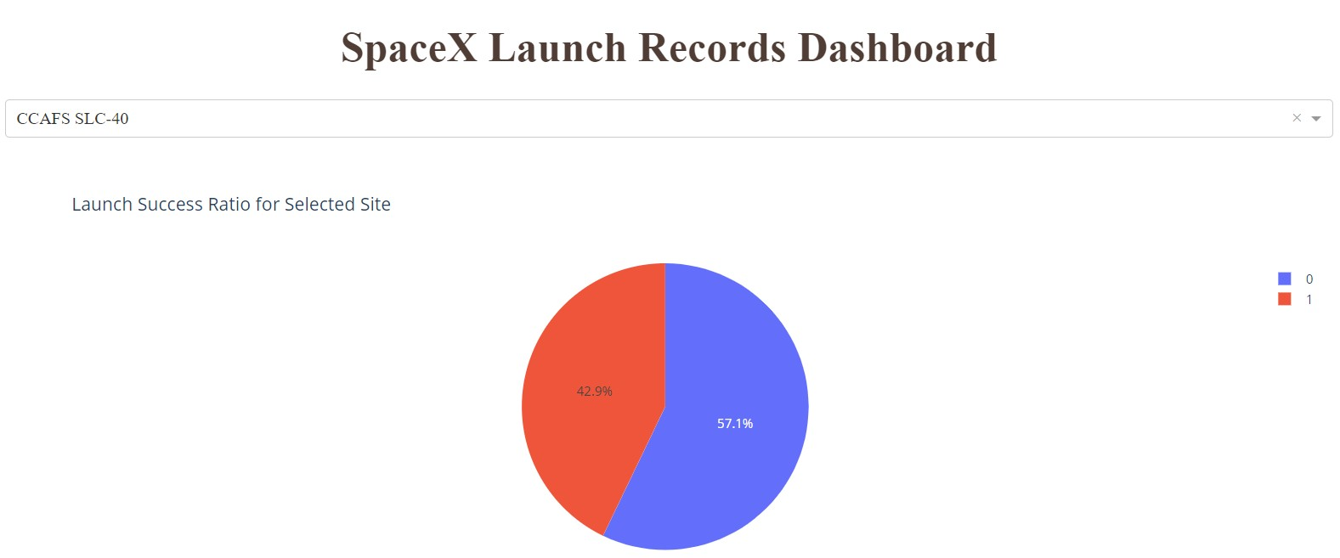
Appendix
The launch success ratio for the CCAFS SLC-40 site was 42.9%.

Slide 53
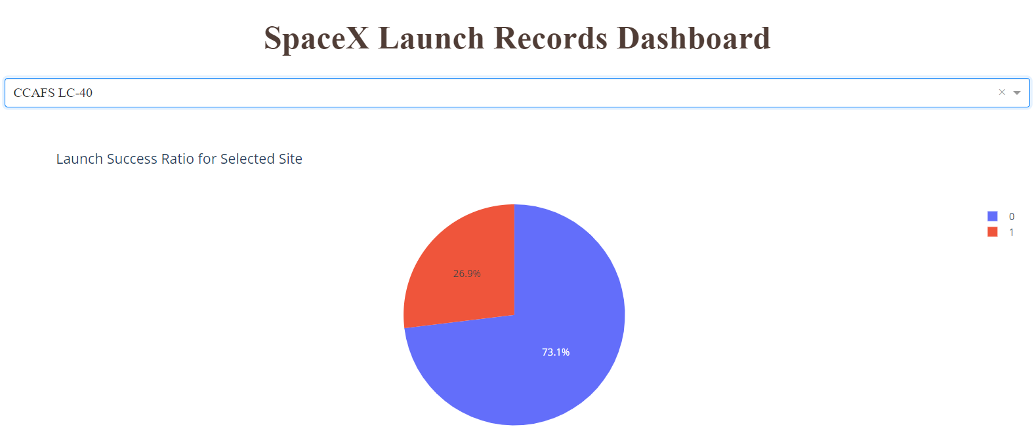
Appendix
The launch success ratio for the CCAFS LC-40 site was 26.9%.
53

Slide 54
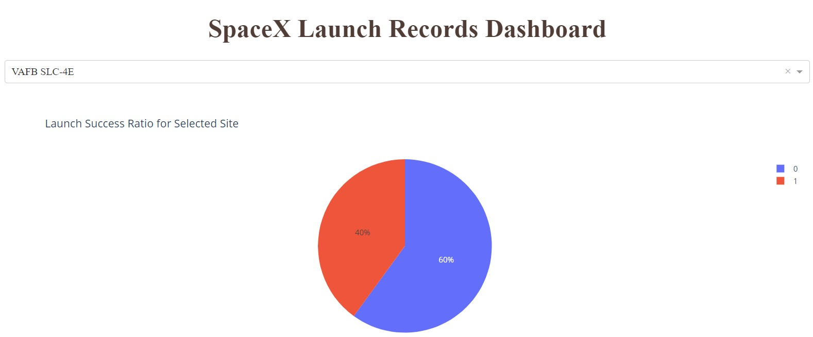
Appendix
The launch success ratio for the VAFB SLC-4E site was 40%.

Slide 55
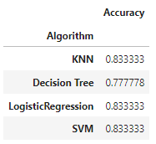
Appendix
The accuracy scores on the test data for the four classification models were as follows:

Slide 56


